Slide 1
NoSQL Vs SQL

Slide 2
Definitions
NoSQL
SQL
is a non-relational database, meaning it allows different structures than a SQL database (not rows and columns) and more flexibility to use a format that best fits the data. The term “NoSQL” was not coined until the early 2000s. It doesn’t mean the systems don’t use SQL, as NoSQL databases do sometimes support some SQL commands. More accurately, “NoSQL” is sometimes defined as “not only SQL.”
Data is stored in and tables that are linked in various ways. One table record may link to one other or to many others, or many table records may be related to many records in another table. These relational databases, which offer fast data storage and recovery, can handle great amounts of data and complex SQL queries.

Slide 3
Data migration process infographics
SQL use case
Performance
A relational (SQL) database is ideal for handling data models that are well-understood, may not change often, require adherence to strict international standards, and for businesses that value data consistency over transaction speed.
NoSQL vs SQL performance comparison is based on attributes like consistency, availability and speed. The needs of an enterprise generally determine which type of database system to use.
NoSQL use case
A non-relational (NoSQL) database is ideal for companies facing changing data requirements, those that can adapt to rapidly-evolving vendor-driven standards and APIs, and those who need to deal with multiple types of data and high traffic volumes.

Slide 4
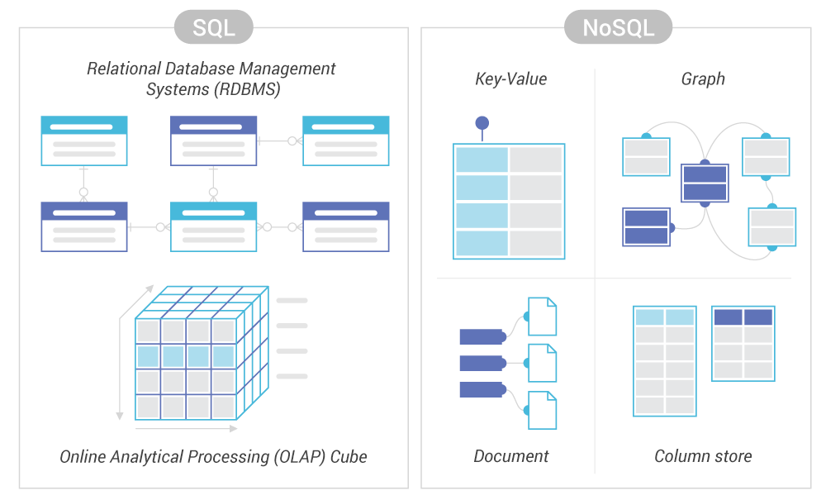

Slide 5
Pros of SQL:
Pros of NoSQL:
Flexible schema
SQL is widely understood and supported; most developers know it well.
SQL is extremely useful for simple aggregations over large datasets, such as calculating averages
Usable on distributed infrastructure platforms
SQL is extremely useful for setting up simple ETL jobs, especially if the input and output formats are relational databases.
Low-cost infrastructure and high availability and throughput

